Slide 1
Brain Tumor Detection Using Hybrid Model Approach (Autoencoder-CNN)
Garima Dubey
Ankita Singh

Slide 2
Problem Identification
Brain tumors present a global health challenge, requiring accurate diagnosis.
This project aims at merging autoencoders with CNNs to streamline brain tumor detection from MRI scans, reducing computational complexity while preserving critical features for precise classification.

Slide 3
Data Preparation
The Data is maintained in two separate Training and Testing Folders.
Data is loaded from specified directories, with each subfolder representing a distinct class label.
Images are standardized by resizing them to a consistent dimension and then normalized.
The 'load_data' function iterates through each class folder, loads images, resizes them to (224, 224) dimensions, converts them to arrays, and appends them to 'images' along with their corresponding labels in 'labels'.

Slide 4
Model Design
Load the MRI Images
Data
Preparation
Autoencoders
(Dimensionality reduction)
CNN Model
Prediction

Slide 5
Implementation
Data Loading and Preprocessing
  Images loaded from directories, each representing a class label.
  Standardization involves resizing to (224, 224) dimensions and normalization.
Autoencoder Architecture for Dimensionality Reduction:
  Architecture includes encoder and decoder for compression and reconstruction.
  Model compiled with mean squared error loss and Adam optimizer.
Autoencoder Training with Early Stopping:
  Early stopping implemented to prevent overfitting during training.
  Training set for 15 epochs with batch size 256, using the same data for validation.

Slide 6
Implementation
Generating Encoded Images
  Trained encoder used to predict encoded representations for training and testing images.
  Original high-dimensional data transformed into lower-dimensional space for subsequent classification task.
CNN Model for Tumor Classification:
  A CNN is designed for classifying brain tumors into four categories.
  The model consists of convolutional and dense layers, with softmax activation for classification.
CNN Training with Early Stopping:
  The CNN is trained using encoded image data with early stopping to prevent overfitting.
  Training halts if validation loss doesn't improve for a specified number of epochs.

Slide 7
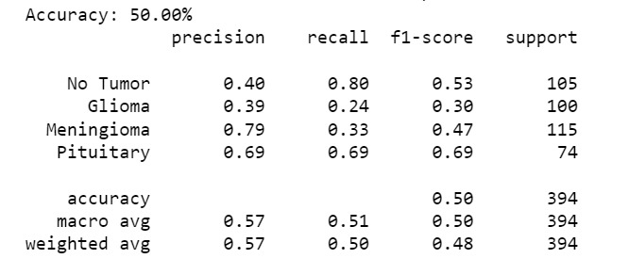
Performance Metrics- Classification Report

Slide 8
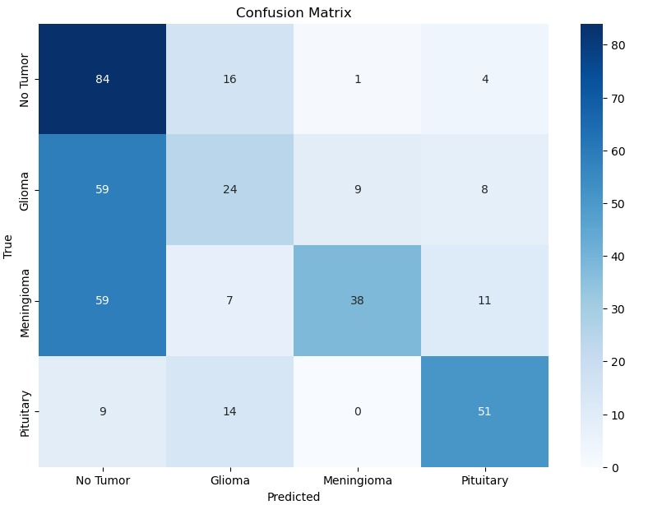
Performance Metrics- Confusion Matrix

Slide 9
Conclusion
No Tumor: High recall but moderate precision indicates that while the model can identify most tumor-free images, it is prone to false positives.
Glioma: Moderate precision with low recall suggests the model is conservative, often missing true Glioma cases.
Meningioma: High precision with moderate recall indicates better feature capture but still misses some Meningioma cases.
Pituitary: Good precision and recall, showing balanced performance in detecting Pituitary tumors effectively.

Slide 10
Limitations & Future Scope
Loss of Information: Crucial details may be lost during data compression.
Overfitting: Potential for poor generalization due to tight fitting to training data.
Sensitivity to Noisy Data: Risk of amplifying noise, affecting feature quality.
Complexity: Autoencoders require careful tuning and can be challenging to train effectively.
Advanced Architectures: Investigate sophisticated models like Variational Autoencoders (VAEs) for better feature handling.
Regularization Techniques: Apply dropout and L1/L2 regularization to combat overfitting.
Hybrid Models: Explore combinations with other neural network types to enhance performance.
Feature Engineering: Enhance extraction capabilities with diverse encoding layers or activations.

